Slide 1
Cornerstone City Church Peninsula Plus Community Hoo Are Ya
30th November 2025

Slide 2
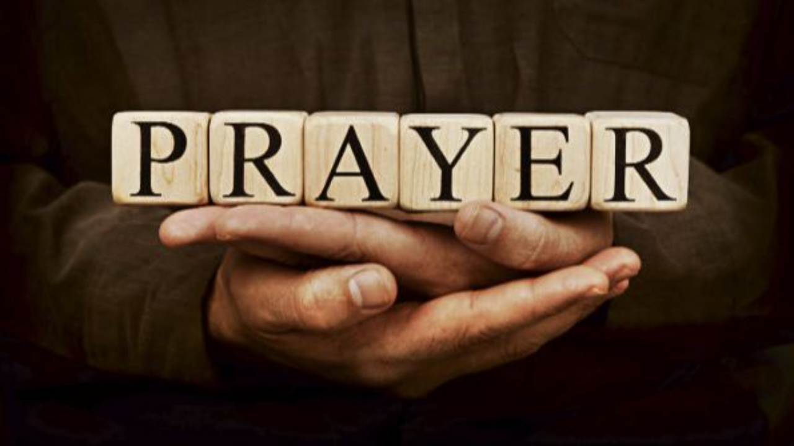

Slide 3
Come Now Is the Time To Worship
CCLI Song # 2430948
Brian Doerksen
© 1998 Vineyard Songs (UK/Eire) (Admin. by Integrity Music Ltd)
For use solely with the SongSelect® Terms of Use. All rights reserved. www.ccli.com
CCLI Licence No. 33265

Slide 4
1/3
Come now is the time to worship
Come now is the time to give your heart
Come just as you are to worship
Come just as you are before your God
Come

Slide 5
2/3
One day every tongue
Will confess You are God
One day every knee will bow
Still the greatest treasure remains
For those who gladly choose You now

Slide 6
1/3
Willingly we choose to surrender our lives
Willingly our knees will bow
With all our heart soul mind and strength
We gladly choose You now

Slide 7
Praise
CCLI Song # 7213077
© Brandon Lake MusicFor Humans PublishingMaverick City PublishingCapitol CMG GenesisCapitol CMG ParagonHousefires SoundsWriter's Roof PublishingMusic by Elevation Worship Publishing
For use solely with the SongSelect® Terms of Use. All rights reserved. www.ccli.com
Note: Reproduction of this sheet music requires a CCLI Music Reproduction Licence. Please report all copies.
CCLI Licence No. 33265

Slide 8
1/12
Let everything that has breath
Praise the Lord
Praise the Lord

Slide 9
2/12
I’ll praise in the valley
Praise on the mountain
I’ll praise when I’m sure
Praise when I’m doubting

Slide 10
3/12
I’ll praise when outnumbered
Praise when surrounded
'Cause praise is the water
My enemies drown in

Slide 11
4/12
As long as I’m breathing
I’ve got a reason to Praise the Lord oh my soul
Praise the Lord oh my soul

Slide 12
5/12
I’ll praise when I feel it
And I’ll praise when I don’t
I’ll praise 'cause I know
You’re still in control

Slide 13
6/12
'Cause my praise is a weapon
It’s more than a sound
My praise is the shout
That brings Jericho down

Slide 14
7/12
As long as I’m breathing
I’ve got a reason to Praise the Lord oh my soul
Praise the Lord oh my soul

Slide 15
8/12
I won’t be quiet
My God is alive
How could I keep it inside
Praise the Lord oh my soul

Slide 16
9/12
I’ll praise 'cause You’re sovereign
Praise 'cause You reign
Praise 'cause You rose and defeated the grave
I’ll praise 'cause You’re faithful
Praise 'cause You’re true
Praise 'cause there’s nobody greater than You

Slide 17
10/12
Praise the Lord oh my soul
Praise the Lord oh my soul
Praise the Lord oh my soul
Praise the Lord oh my soul
I won’t be quiet
My God is alive
How could I keep it inside

Slide 18
1 1/12
I won’t be quiet
My God is alive
How could I keep it inside
I won’t be quiet
My God is alive
How could I keep it inside
Praise the Lord oh my soul

Slide 19
12/12
Let everything that has breath
Praise the Lord
Praise the Lord

Slide 21
Gratitude
CCLI Song # 7158417
Benjamin Hastings | Brandon Lake | Dante Bowe
© 2019 SHOUT! Music Publishing Australia; Bethel Music Publishing; Bethel Worship Publishing; Brandon Lake Music; Maverick City Publishing; Maverick City Publishing Worldwide
For use solely with the SongSelect® Terms of Use. All rights reserved. www.ccli.com
CCLI Licence No. 33265

Slide 22
1/7
All my words fall short
I got nothing new
How could I express
All my gratitude

Slide 23
2/7
I could sing these songs
As I often do
But every song must end
And You never do

Slide 24
3/7
So I throw up my hands
And praise You again and again
‘Cause all that I have is a hallelujah hallelujah
And I know it’s not much
But I’ve nothing else fit for a king
Except for a heart singing hallelujah
Hallelujah

Slide 25
4/7
I’ve got one response
I’ve got just one move
With my arms stretched wide
I will worship You

Slide 26
5/7
So I throw up my hands
And praise You again and again
‘Cause all that I have is a hallelujah hallelujah
And I know it’s not much
But I’ve nothing else fit for a king
Except for a heart singing hallelujah
Hallelujah

Slide 27
6/7
Come on my soul
Oh don’t you get shy on me
Lift up your song
‘Cause you’ve got a lion inside of those lungs
Get up and praise the Lord (REPEAT)

Slide 28
7/7
So I throw up my hands
And praise You again and again
‘Cause all that I have is a hallelujah hallelujah
And I know it’s not much
But I’ve nothing else fit for a king
Except for a heart singing hallelujah
Hallelujah

Slide 29
1/2
Come on and praise the Lord with me
Sing if you love His name
Come on and lift your voice with me
He’s worthy of all our praise

Slide 30
2/2
Come on and bring your offering
Sing if you’ve known His grace
Come on and lift up your holy hands
He’s worthy of all our praise He’s worthy of all our praise

Slide 32
Holy Forever
CCLI Song # 7201044
Brian Johnson | Chris Tomlin | Jason Ingram | Jenn Johnson | Phil Wickham
© Phil Wickham Music (Admin. by / Small Stone Media BV, Holland (Admin. in the UK/Eire by Song Solutions www.songsolutions.org))
Simply Global Songs (Admin. by / Small Stone Media BV, Holland (Admin. in the UK/Eire by Song Solutions www.songsolutions.org))
Capitol CMG Paragon (Admin. by Capitol CMG Publishing)
S. D. G. Publishing (Admin. by Capitol CMG Publishing)
Be Essential Songs (Admin. by Essential Music Publishing LLC)
My Magnolia Music (Admin. by Essential Music Publishing LLC)
Bethel Music Publishing (Admin. by Song Solutions)
Brian and Jenn Publishing (Admin. by Song Solutions)
For use solely with the SongSelect® Terms of Use. All rights reserved. www.ccli.com
CCLI Licence No. 33265

Slide 33
1/10
A thousand generations falling down in worship
To sing the song of ages to the Lamb
And all who've gone before us
And all who will believe
Will sing the song of ages to the Lamb

Slide 34
2/10
(Jesus) Your name is the highest
Your name is the greatest
Your name stands above them all
All thrones and dominions
All powers and positions
Your name stands above them all

Slide 35
3/10
And the angels cry Holy
All creation cries Holy
You are lifted high Holy
Holy forever

Slide 36
4/10
If you've been forgiven and if you've been redeemed
Sing the song forever to the Lamb
If you walk in freedom and if you bear His name
Sing the song forever to the Lamb
We'll sing the song forever and amen

Slide 37
5/10
And the angels cry Holy
All creation cries Holy
You are lifted high Holy
Holy forever

Slide 38
6/10
Hear Your people sing Holy
To the King of Kings Holy
You will always be Holy
Holy forever

Slide 39
7/10
(Jesus) Your name is the highest
Your name is the greatest
Your name stands above them all
All thrones and dominions
All powers and positions
Your name stands above them all

Slide 40
8/10
And the angels cry Holy
All creation cries Holy
You are lifted high Holy
Holy forever

Slide 41
9/10
Hear Your people sing Holy
To the King of Kings Holy
You will always be Holy
Holy forever

Slide 42
10/10
You will always be Holy
Holy forever

Slide 43


Slide 44
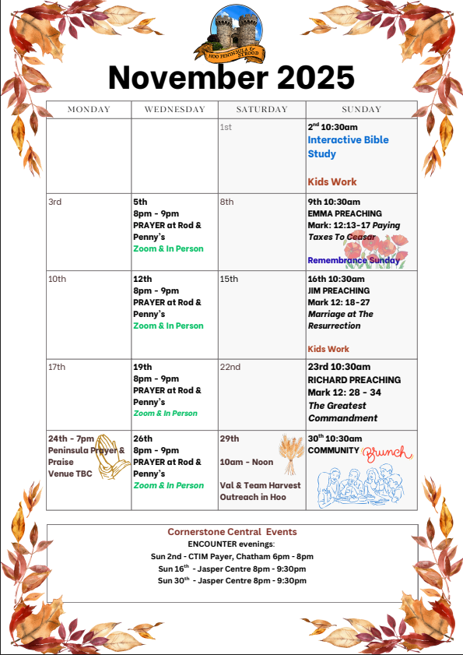

Slide 45
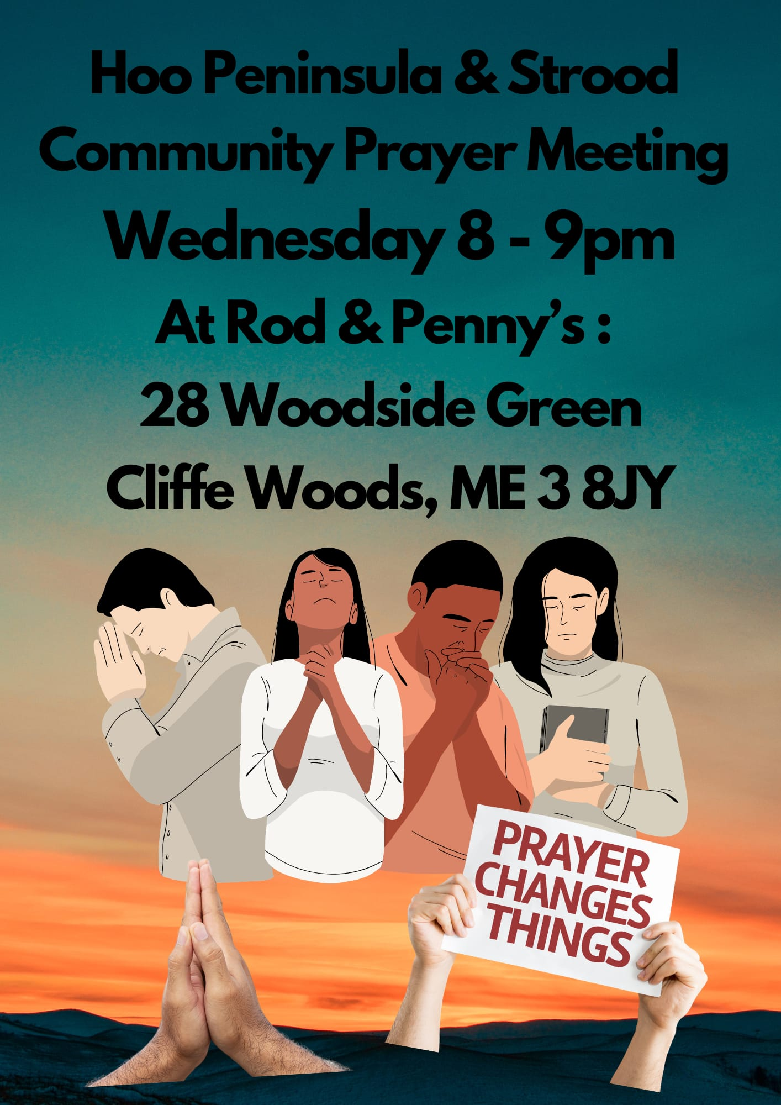

Slide 46
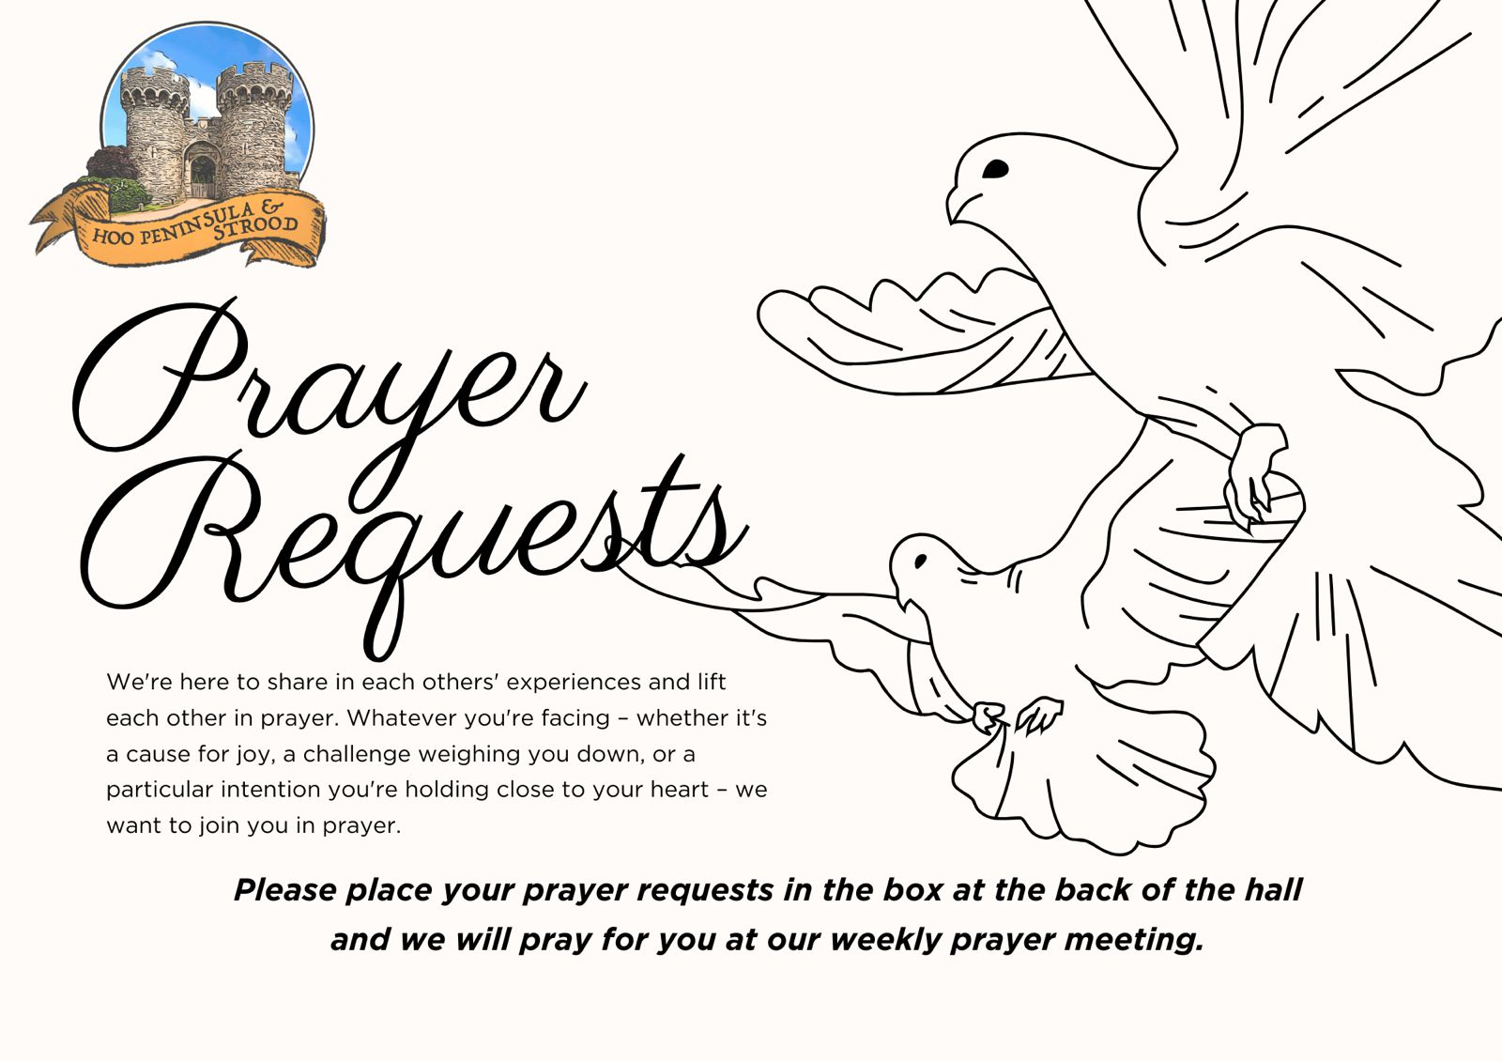

Slide 47

Grow Group 1
On YOUR MARK!

Slide 48
Leaders
Leaderss
Phil & Kim
Maria (Mia) Warren
Matthew Harrison
Richard & Elisha Acheampong
Phil & Kim
Maria (Mia) Warren
Matthew Harrison
Richard & Elisa Acheampong

Slide 49
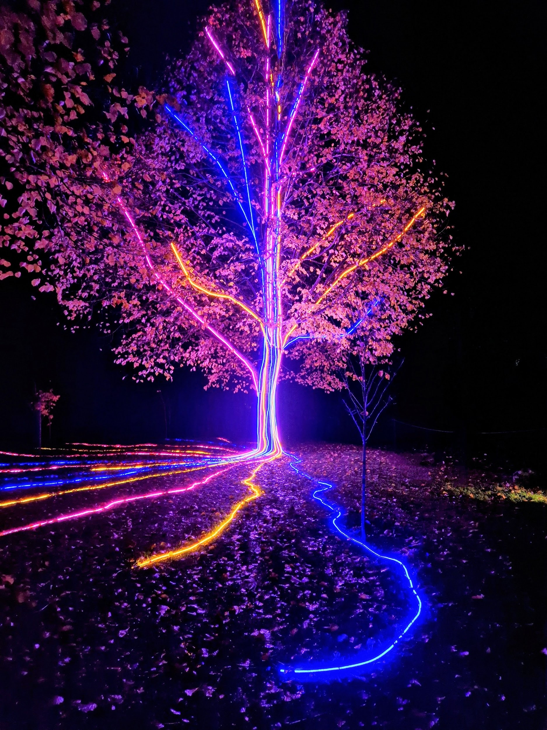
Storm Walker
Storm Walker
Symbolising, trust in Jesus Christ through life's storms.
Mark 4:35-41

Slide 50



Group Leaders
Micheal and Mwamba
Wilfred and Parveen
Hannah

Slide 51
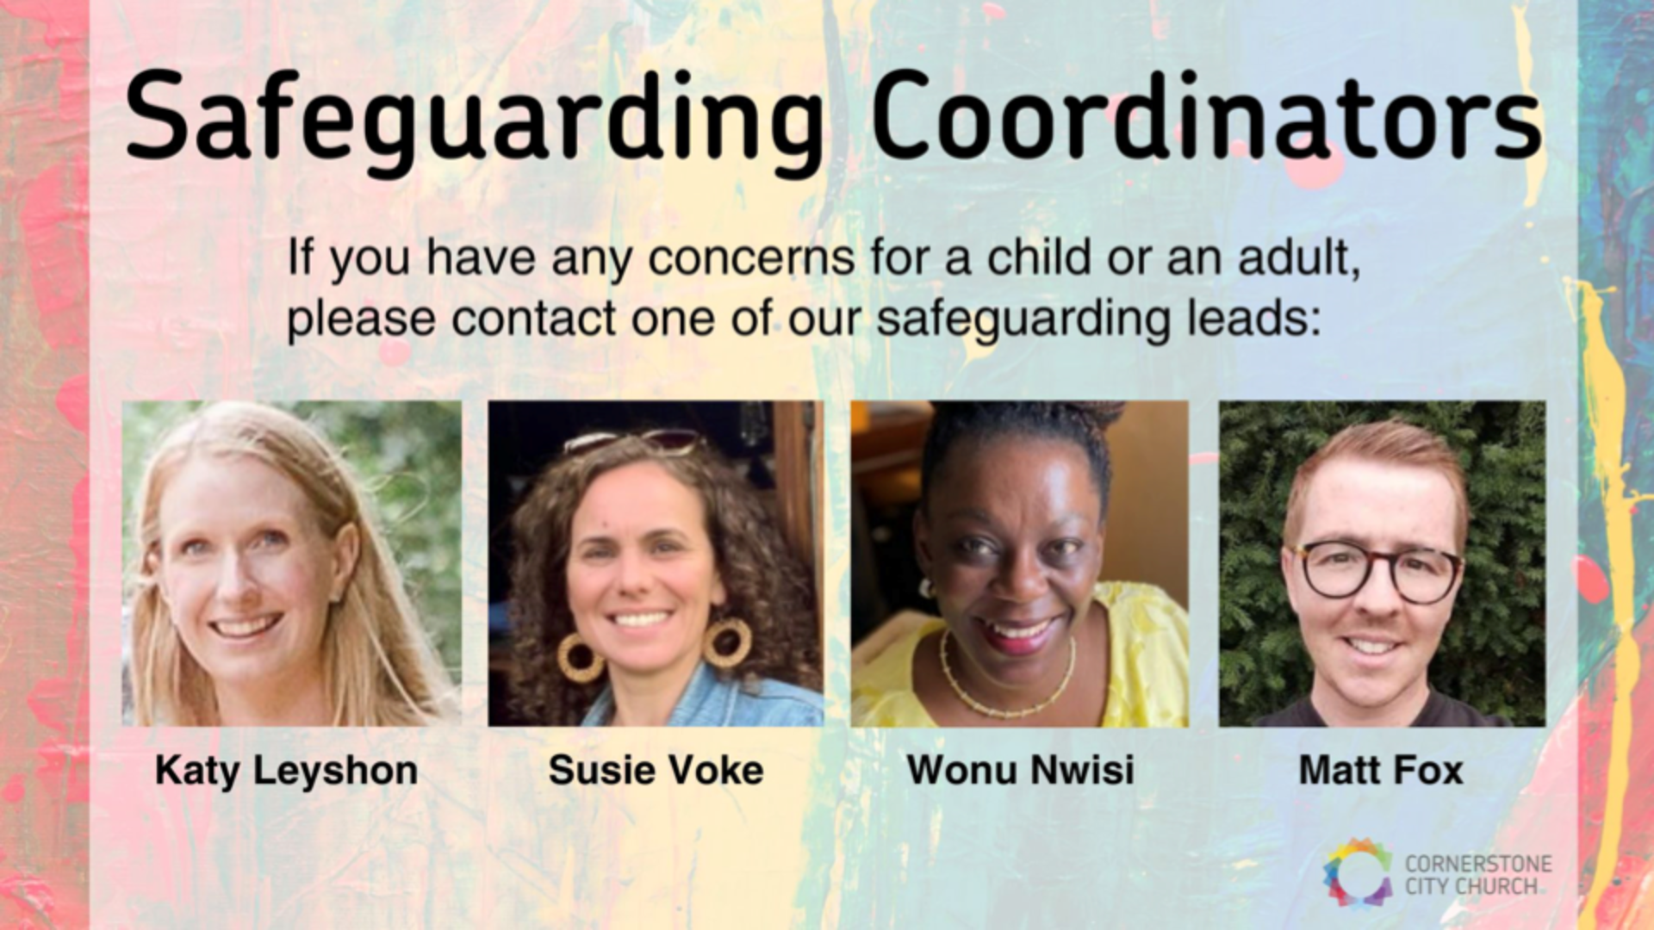

Slide 52


Slide 53
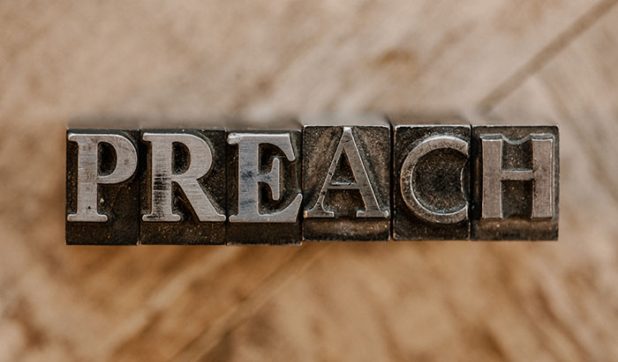

Slide 54
2 Corinthians 14 May the grace of the Lord Jesus Christ, and the love of God, and the fellowship of the Holy Spirit be with you all
Surely goodness and mercy shall follow us all the days of our lives, and we shall dwell in the house of the Lord forever.

